Slide 1
NLP MINI PROJECT
AUTOMATIC ASSIGNMENT OF incident TICKETS
M. SHRUTHI - 2018103592
K.S. SUMAIYA FATHIMA - 2018103607

Slide 2
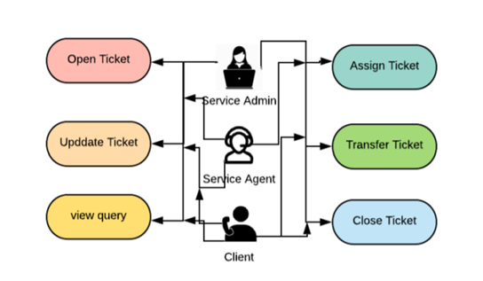
INTRODUCTION
Incidents are issues or unplanned interrupts to IT services.
Incidents are processed using a ticketing system.
Traditional methods have resulted in human error (assigning tickets to wrong time) which led to high waiting time, customer dissatisfaction.
Ticket assigning system will lead to better resource allocation and cost savings.
Incoming issues are analyzed and assessed by organizations support team to fulfil the request.

Slide 3
OBJECTIVES
DATASET
To automate the process of assigning tickets to reduce human error and faster the process.
Objectives are as follows:
Understand the data
Perform EDA.
Plot graphs and visualize.
Pre-process the data.
Try Different embeddings:
Tf-Idf.
Word2Vec.
Try for different models and different epochs.
The dataset consists of 4 columns:
Short Description
Description
Caller id
Assignment group
Each group addresses different set of problems arised by the customers.

Slide 4
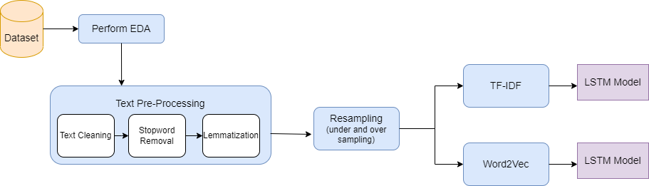
Methodology diagram

Slide 5
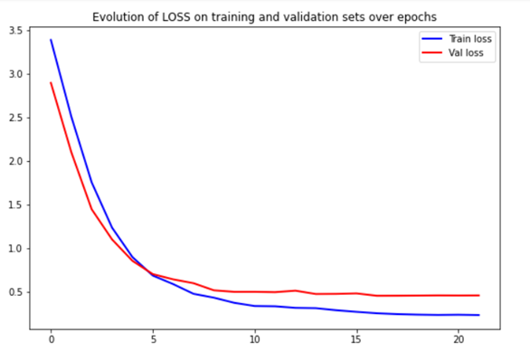
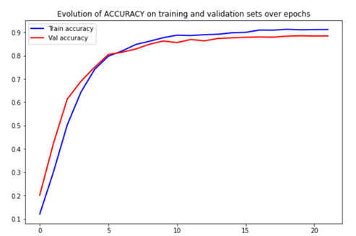
PERFORMANCE
MODEL | LOSS | ACCURACY
LSTM with Tf-Idf | Train - 1.2311 Val - 3.6114 | Train - 0.6303 Val - 0.3397
LSTM with Word2Vec (without sampling) | Train - 1.0529 Val - 1.5651 Train - 0.8825 Val - 1.6644 | Train - 0.6940 Val - 0.6188 Train - 0.7397 Val - 0.6082
LSTM with Word2Vec (with sampling) | Train - 0.3832 Val - 0.5105 Train - 0.2327 Val - 0.4576 | Train - 0.8729 Val - 0.8479 Train - 0.9120 Val - 0.8842

